Slide 1
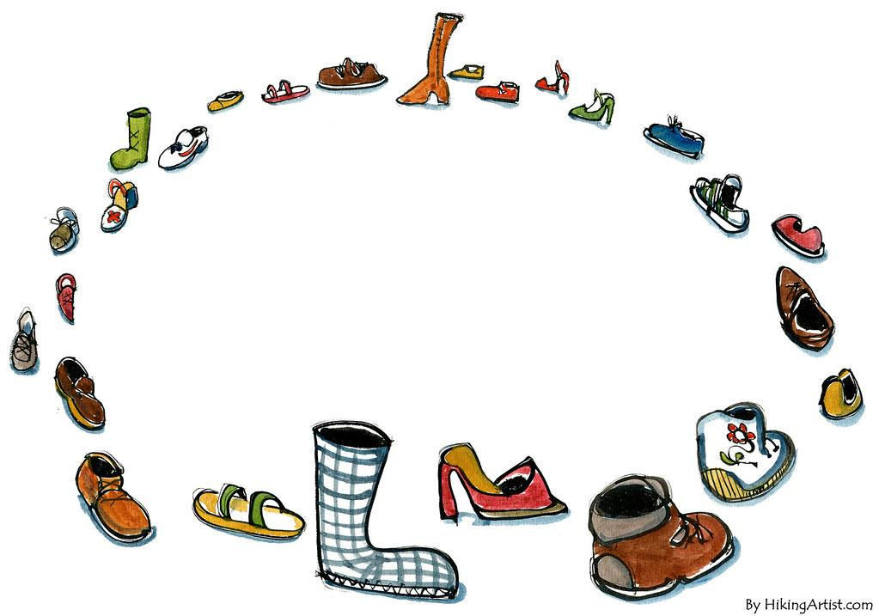
Whose Shoes?

Slide 2
Remember last week?
WOW! Last week we learned about the grocery store. Can you tell me who you might see in the grocery store?
Can you tell me some of the things we can buy in the grocery store?
What recipe did you create with mommy?

Slide 3
Whose Shoes?
I am going to show you some shoes. I want you to guess who may wear the shoes.
After we guess who can wear the shoes, let’s describe the shoe. Tell me what the shoe is made of, for example: leather, cloth, satin, plastic, etc…
What occupation someone may have based on the type of shoe that is worn?

Slide 4
Whose Shoes?

Slide 5
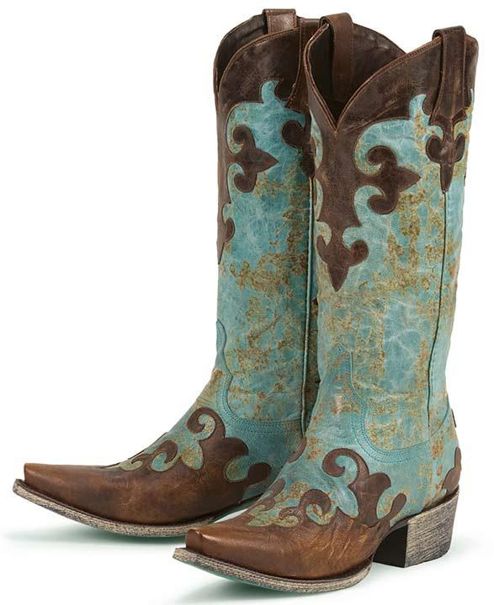
Whose Shoes?

Slide 6
Whose Shoe?

Slide 7
Whose Shoes?

Slide 8
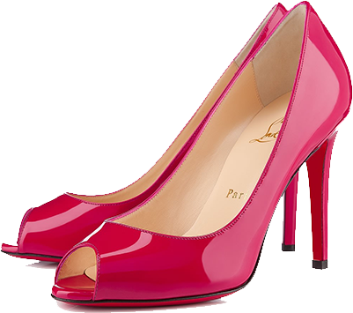
Whose Shoes?

Slide 9
Whose Shoes?

Slide 10
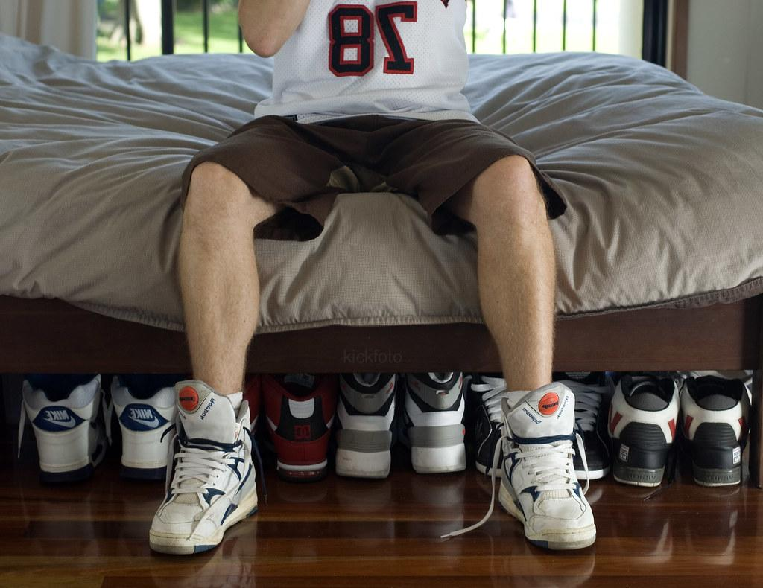
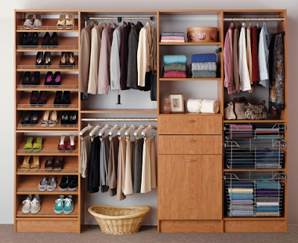
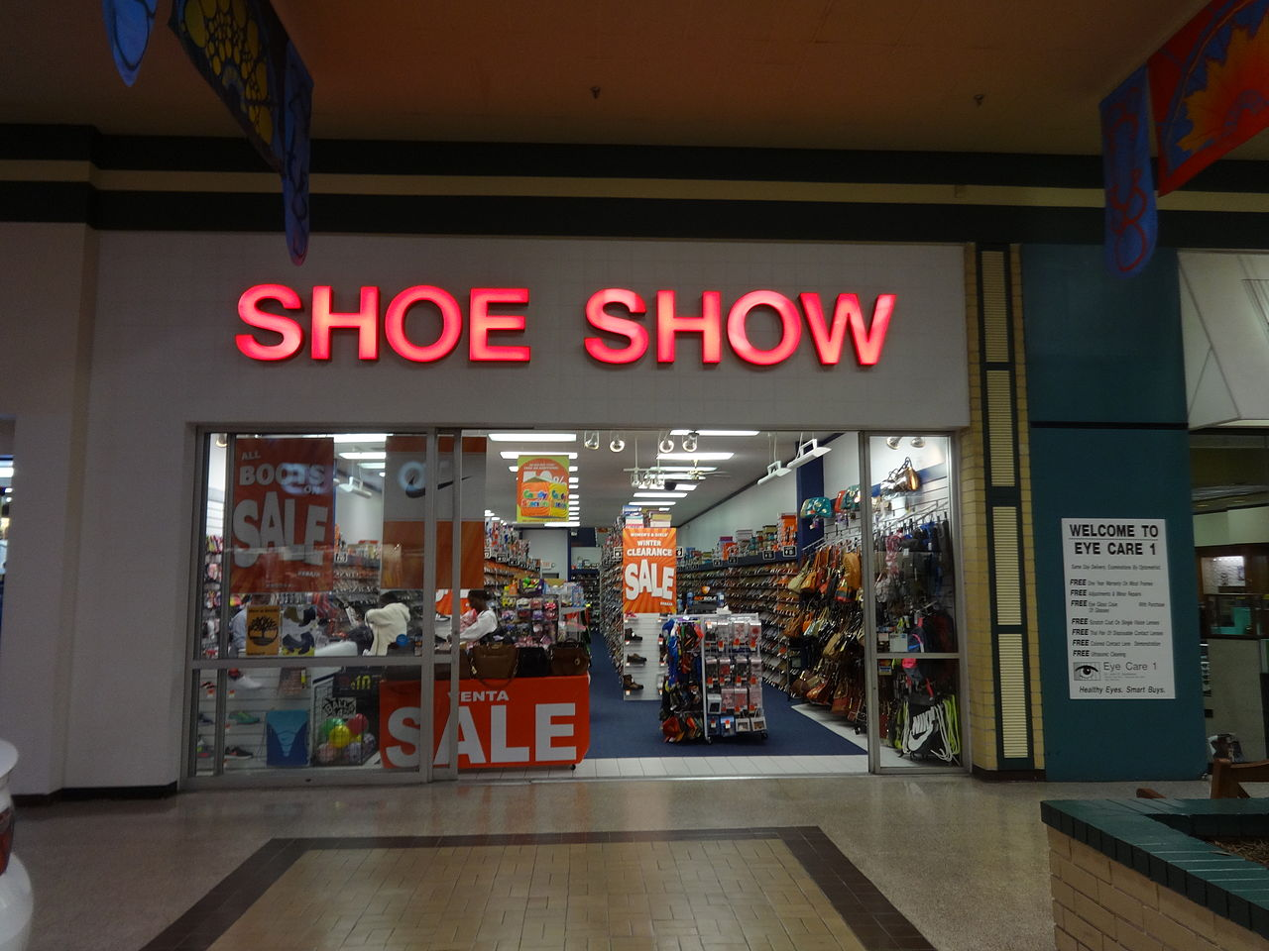
Where can I find shoes?
Under the bed.
Shoe Store.
In the closet.

Slide 11
Those Shoes
https://www.youtube.com/watch?v=LjUFJEduguk

Slide 12
Advance Words

Slide 13
Velcro
A fastener for clothes or other items consisting of two strips of thin plastic sheet; one covered with tiny loops, and the other with tiny flexible hooks which adhere when pressed together and can be separated when pulling apart deliberately.

Slide 14
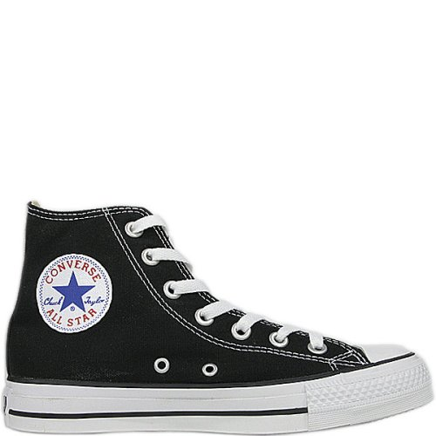
High-tops
Shoes or sneakers that extend over the ankle.

Slide 15
Boots
A sturdy item of footwear covering the foot, ankle, and sometimes the leg below the knee.

Slide 16
Grip
Take and keep a firm hold of; grasp tightly.

Slide 17
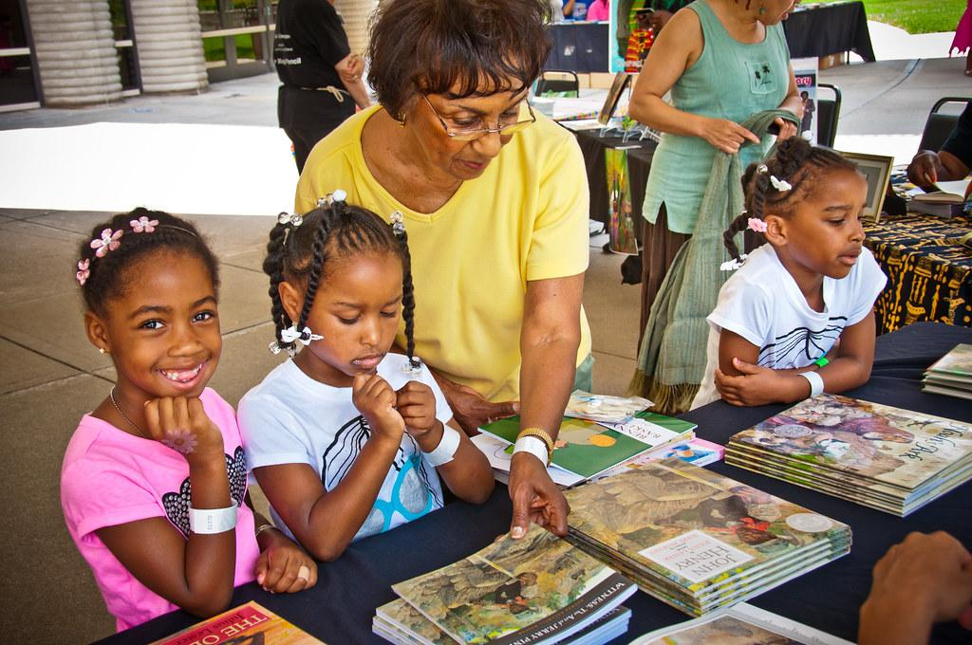
Book Reflections
Can shoes make you a fast runner?
Why do you think he needed new boots?
Have you ever been to a shoe store?
Why do you think he was so excited?
What color is your favorite pair of shoes.

Slide 18
Parts of the Shoe
This Photo by Unknown Author is licensed under CC BY-SA

Slide 19
Family Activities

Slide 20
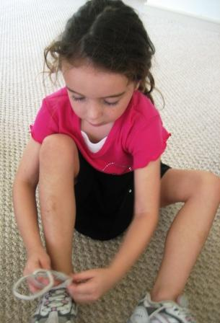
Shoe Comparisons
This fun and easy activity will support learning about measurements and comparing the lengths of items.
Materials Needed: ▪ Different sizes of shoes.
Step by Step:
Have the child use the shoe as a measurement tool.
Say, “Can you find four things in the room that are shorter than your shoe?”
Use math vocabulary such as measure, compare, length, shorter, and longer to discuss the objects the child finds.
Next, ask the child to find four objects that are longer than the shoe.
Enjoy.

Slide 21
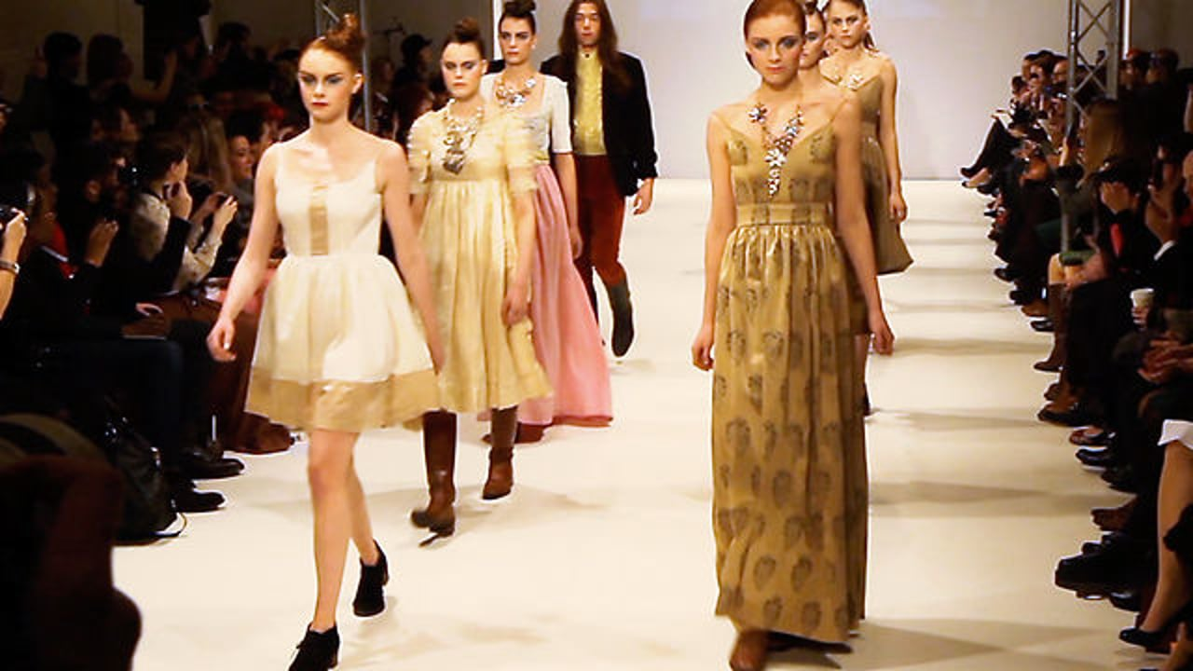
Shoe Show
As a family everyone should put on their favorite shoes.
Turn down the lights, and turn on a flash light or the light on your phone.
Play your favorite song, and allow the child to describe the shoes.
Talk about the color.
Talk about the shape.
Talk about what the shoes are made of.
Sample song: “These Boots Are Made for Walkin’” by Jessica Simpson.

Slide 22
Table Talk
Mom/Dad, how are you doing?
Mom/Dad, do you know what school your child will be attending next school year?
Below is the link for Head Start and Early Head Start applications:
https://www.childplus.net/apply/en-us/B2855EBC0789C05E2CA908C3D052D221/28E9AAC9CDC89AF31E41FB50DF40D527

Slide 23
Resources
https://www.youtube.com/watch?v=kBi_RoXKVo0
Shoe La-La
https://www.youtube.com/watch?v=7IR-RozRcjE
How to tie your shoes
https://www.youtube.com/watch?v=WyhgubvRYF4
READ ALONG with MICHELLE OBAMA | The Gruffalo | PBS KIDS

Slide 24
AdditionalResources
YouTube:
https://www.youtube.com/watch?v=kBi_RoXKVo0
Shoe La-La
https://www.youtube.com/watch?v=7IR-RozRcjE
How to tie your shoes
https://www.youtube.com/watch?v=WyhgubvRYF4
READ ALONG with MICHELLE OBAMA | The Gruffalo | PBS KIDS
https://www.youtube.com/watch?v=LjUFJEduguk
Othandra “OT” Hicks: Shoe Comparison – Family Activity
Pee Dee Community Action Partnership: Application
https://www.childplus.net/apply/en-us/B2855EBC0789C05E2CA908C3D052D221/28E9AAC9CDC89AF31E41FB50DF40D527

